Slide 1
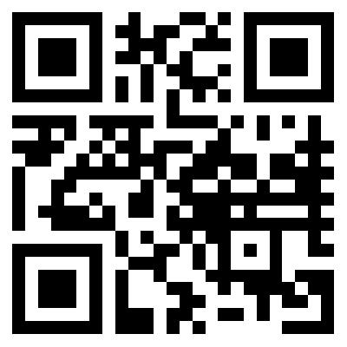
Web 2.0!
Ellie Rashid

Slide 2
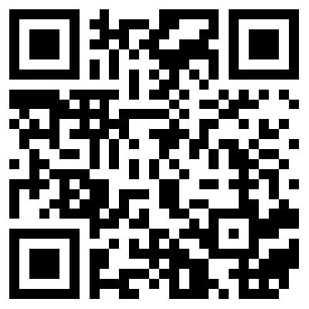
What is it?
Shift in the way digital information is:
Created
Shared
Stored
Distributed
Manipulated

Slide 3
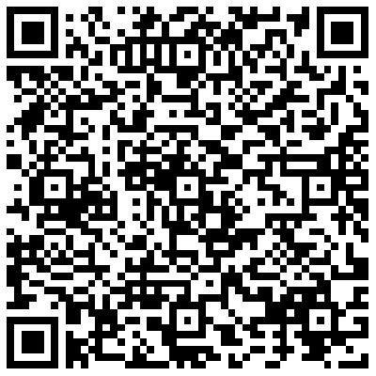
Web 2.0: tools for educators
Free, interactive poster generator
Looks like a poster but is interactive!
Glogster!

Slide 4
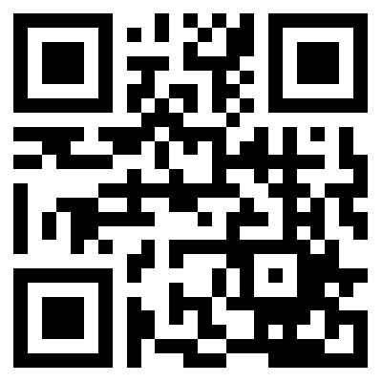
Web 2.0: tools for educators
Like YouTube but for teachers
Free, educational video database for teachers
Also provides audio, photo and document resources
TeacherTube!

Slide 5
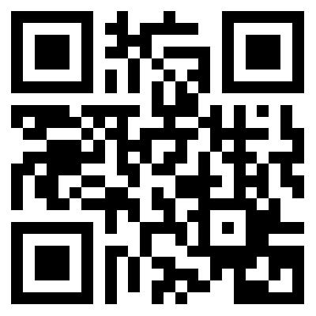
Web 2.0: tools for educators
Free, online format converter
Converts songs, videos, images and documents from one form to another, quickly.
Transformed media is emailed once finished
Zamzar!

Slide 6
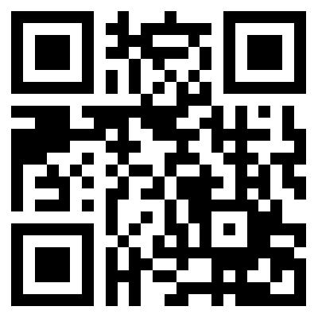
Web 2.0: tools for educators
Free, online website generator
Teachers can create a classroom website
Access to parents
Access to students
Weebly!

Slide 7
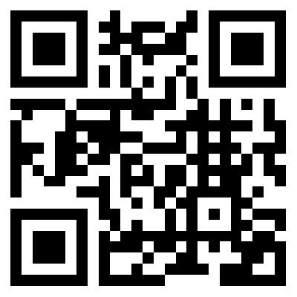
Web 2.0: tools for Students
Free database of resources pertaining to many areas of study
Can be used as study materials and reinforcement for students
Khan Academy!

Slide 8
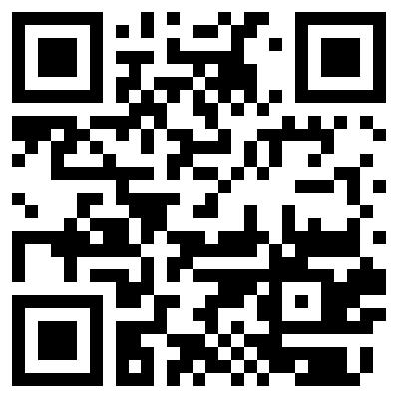
Web 2.0: tools for Students
Flashcard creation website
Create and share sets of cards to other people
Study cards in different formats
My Favorite!!
Quizlet!

Slide 9
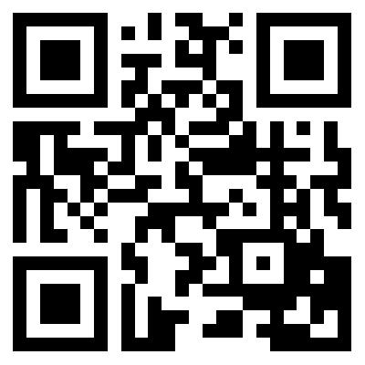
Web 2.0: tools for Students
Free, bibliography maker
Automatically cites books, magazines, newspapers etc. and creates a works cited.
BibMe!

Slide 10
I found this project quite interesting. Before we began I really didn’t have much idea of what a QR code was. Now that I am informed, I see them everywhere! Since beginning the project, I have used my QR app several times in different situations. It was cool to be able to create our own code and link it to whatever we wanted. I didn’t have any trouble with the websites that create these codes. They all worked perfectly and I was able to link anything I wanted without difficulty.
There are many uses for QR codes outside of the classroom, but just as many uses inside the classroom! A teacher could easily set up a QR code treasure hunt. One code could lead to another and that code to another, etc. These codes are easy and fun for kids to use and could really enhance the learning of all children!

